Slide 1
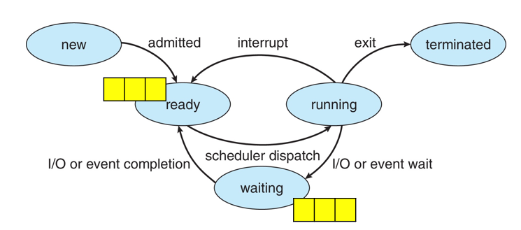
Round Robin Scheduling Algorithm
Round Robin is a CPU scheduling algorithm where each process is assigned a fixed time slot in a cyclic way.
Algorithm comes from the round-robin principle, where each process gets an equal share of time in turns
It is simple, easy to implement, and starvation-free as all processes get fair
share of CPU
It is preemptive as processes are assigned CPU only for a fixed slice of time at most. Fix time slice to execute, is called a Quantum. Mostly used for multitasking.
The disadvantage of it is more overhead of context switching.
Process | AT | BT | CT | TAT | WT | RT
P1 | 0 | 5
P2 | 1 | 7
P3 | 3 | 4
P3
P2
P1
time quantum = 2 unit

Slide 2
Round Robin Scheduling Algorithm
Process | AT | BT | CT | TAT | WT | RT
P1 | 0 | 5 | 11
P2 | 1 | 7 | 16
P3 | 3 | 4 | 13
time quantum = 2 unit
Avg W.T =
Avd TAT =
Avg RT =
0
1
2
3
Ready Queue
P1 | P2 | P1 | P3 | P2 | P1 | P3 | P2
0
2
4
6
8
10
11
13
16
18
20
Gantt Chart
P1 | P2 | P1 | P3 | P2 | P1 | P3 | P2

Slide 3
Process | AT | BT | CT | TAT | WT | RT
P1 | 0 | 5
P2 | 1 | 3
P3 | 2 | 1
P4 | 3 | 2
P5 | 4 | 3
Average Turn Around time =
Average waiting time =

Slide 4
Process | AT | BT | CT | TAT | WT | RT
P1 | 0 | 5 |  | 13 | 8
P2 | 1 | 3 |  | 11 | 8
P3 | 2 | 1 |  | 3 | 2
P4 | 3 | 2 |  | 6 | 4
P5 | 4 | 3 |  | 10 | 7
Average Turn Around time = 8.6 unit
Average waiting time = 5.8 unit

Slide 5
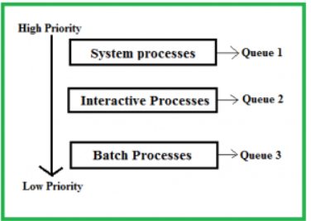
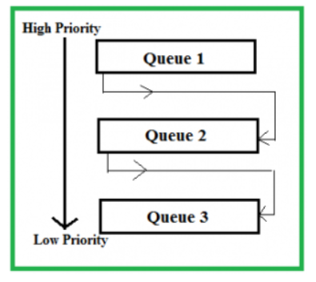
Multilevel Queue Scheduling VS
Multilevel Feedback-Queue Scheduling

